Slide 1
Data Structure
Fall 2016
MW
http://smart.hallym.ac.kr
Instructor: Jin Kim
010-6267-8189(033-248-2318)
  jinkim@hallym.ac.kr
  Office Hours: M 12:15-1, Tu 3:30-5pm M 2-3pm, W 2-3:30

Slide 2
Prerequisites
We expect that you already know the Java programming language at an introductory level
You should be capable of writing a program with at least two Java classes from scratch
If you can not, you should NOT take this course. See your advisor for other options such as retaking java course

Slide 3
Welcome to Data structure
Textbook is ?.

Slide 4
Course Procedures
One lecture sessions each week
  Held in this classroom
  Slides and demonstrations, but no hands-on(실제하기)
I recommend that you print copies of my lecture notes and bring them to each lecture
One lab session each week
  Hands-on work associated with the lectures
  Lab report must be turned in the following week

Slide 5
Trees: Outline
Binary Search Tree (이진 탐색 트리)
Heap(히프)
Selection Tree(선택 트리)

Slide 6
Binary Search Trees (1/8)
Why do binary search trees need?
  Heap is not suited for applications in which arbitrary elements are to be deleted from the element list
    a min (max) element is deleted O(log₂n)
    deletion of an arbitrary element O(n)
    search for an arbitrary element O(n)
Definition of binary search tree:
  Every element has a unique key
  The keys in a nonempty left subtree (right subtree) are smaller (larger) than the key in the root of subtree
  The left and right subtrees are also binary search trees

Slide 7
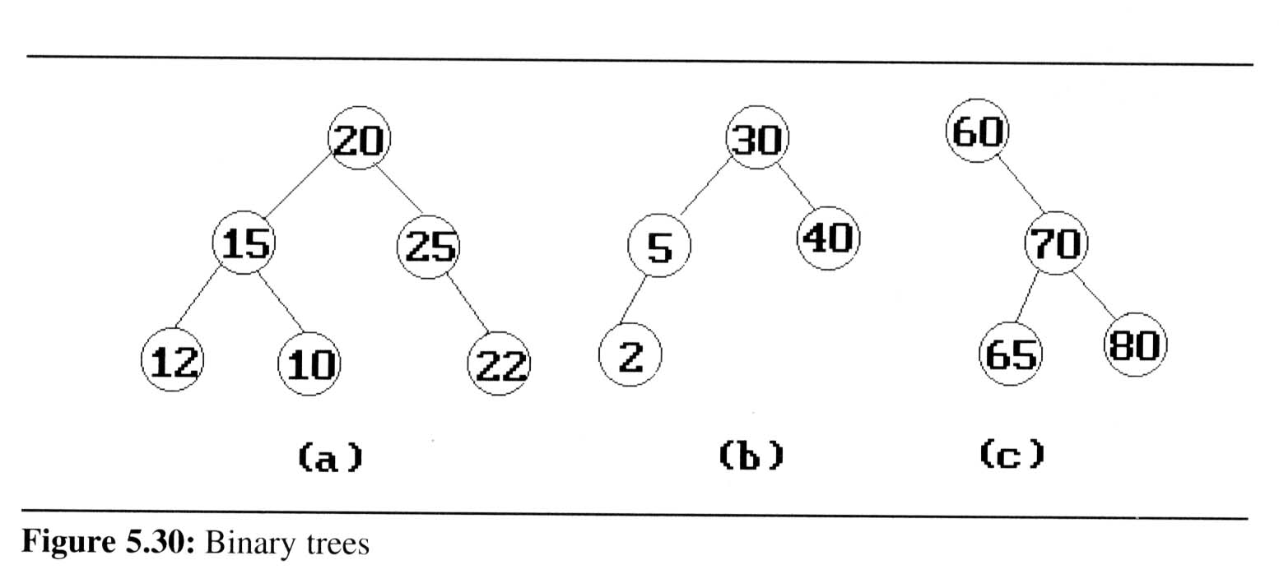
Binary Search Trees (2/8)
Example: (b) and (c) are binary search trees
medium
smaller
larger

Slide 8
Binary Trees
30
60
20
5
40
70
15
25
65
80
14
10
22
2
Not binary search tree
Binary search trees

Slide 9
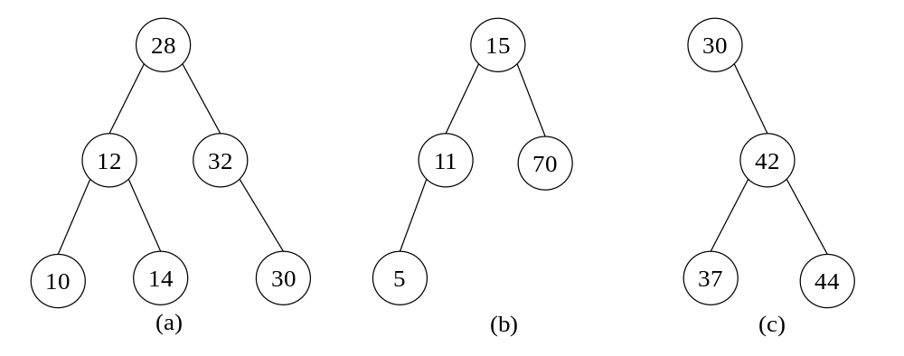
(a) : not bt
(b),(c) : binary search tree

Slide 10
Searching A Binary Search Tree
Always search starts from the root.(트리는 항상루트부터)
If the root is null, then this is an empty tree. No search is needed.
If the root is not null, compare the x(탐색원소) with the key of root.
  If x equals to the key of the root, then it’s done.
  If x is less than the key of the root, then no elements in the right subtree can have key value x. We only need to search the left tree.
  If x larger than the key of the root, only the right subtree is to be searched.

Slide 11
Binary Search Trees (3/8)
Search:
Search(25)
Search(76)
44
17
88
32
65
97
28
54
82
29
76
80

Slide 12
search(10)
12
9
16
2
11
13
21
1
3
10

Slide 13
search(10)
12
9
16
2
11
13
21
1
3
10

Slide 14
search(10)
12
9
16
2
11
13
21
1
3
10

Slide 15
search(10)
12
9
16
2
11
13
21
1
3
10

Slide 16
search(10)
12
9
16
2
11
13
21
1
3
10

Slide 17
search(10)
12
9
16
2
11
13
21
1
3
10

Slide 18
Binary Search Trees (4/8)
Searching a binary search tree
Node structure
left
key
right
  searchBST(B, x)
  // B는 이원 탐색 트리
  // x는 탐색 키 값
  p ← B;
  if (p = null) then // 공백 이진 트리로 실패
  return null;
  if (p.key = x) then // 탐색 성공
  return p;
  if (p.key < x) then // 오른쪽 서브트리 탐색
  return searchBST(p.right, x);
  else return searchBST(p.left, x); // 왼쪽 서브트리 탐색
  end searchBST()

Slide 19
Insertion To A Binary Search Tree
Before insertion is performed, a search must be done to make sure that the value to be inserted is not already in the tree.
If the search fails, then we know the value is not in the tree. So it can be inserted into the tree.
It takes O(h) to insert a node to a binary search tree.

Slide 20
Inserting Into A Binary Search Tree
30
30
5
40
5
40
2
80
2
35
80
Insert(80)
Insert(35)

Slide 21
insert(14)
12
9
16
2
11
13
21
1
3
10

Slide 22
insert(14)
12
9
16
2
11
13
21
1
3
10

Slide 23
insert(14)
12
9
16
2
11
13
21
1
3
10

Slide 24
insert(14)
12
9
16
2
11
13
21
1
3
10

Slide 25
insert(14)
12
9
16
2
11
13
21
1
3
10
14

Slide 26
Binary Search Trees (5/8)
Inserting into a binary search tree
  insertBST(B, x)
  // B는 이원 탐색 트리, x는 삽입할 원소 키 값
  p ← B;
  while (p ≠ null) do {
  // 삽입하려는 키 값을 가진 노드가 이미 있는지 검사
  if (x = p.key) then return;
  q ← p; // q는 p의 부모 노드를 지시
  if (x < p.key) then p ← p.left;
  else p ← p.right;
  }
  newNode ← getNode(); // 삽입할 노드를 만듦
  newNode.key ← x;
  newNode.right ← null;
  newNode.left ← null;
  if (B = null) then B ← newNode; // 공백 이원 탐색 트리인 경우
  else if (x < q.key) then // q는 탐색이 실패로 종료하게 된 원소
  q.left ← newNode;
  else
  q.right ← newNode;
  return;
  end insertBST()

Slide 27
Binary Search Trees (6/8)
Deletion from a binary search tree
  Three cases should be considered
  case 1. leaf → delete
  case 2.
  one child → delete and change the pointer to this child
  case 3. two child → either the smallest element in the right subtree or the largest element in the left subtree

Slide 28
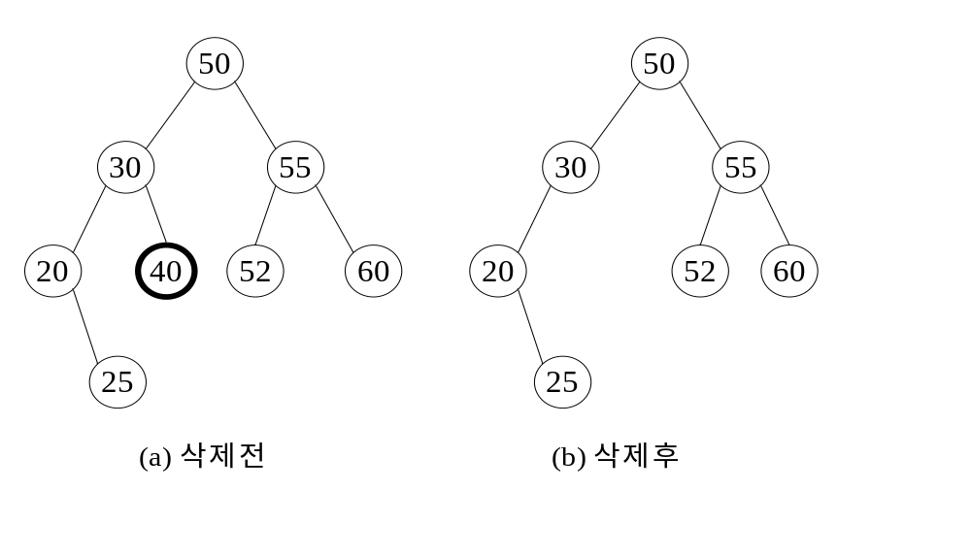
BST
Case1 : leaf node deletion

Slide 29
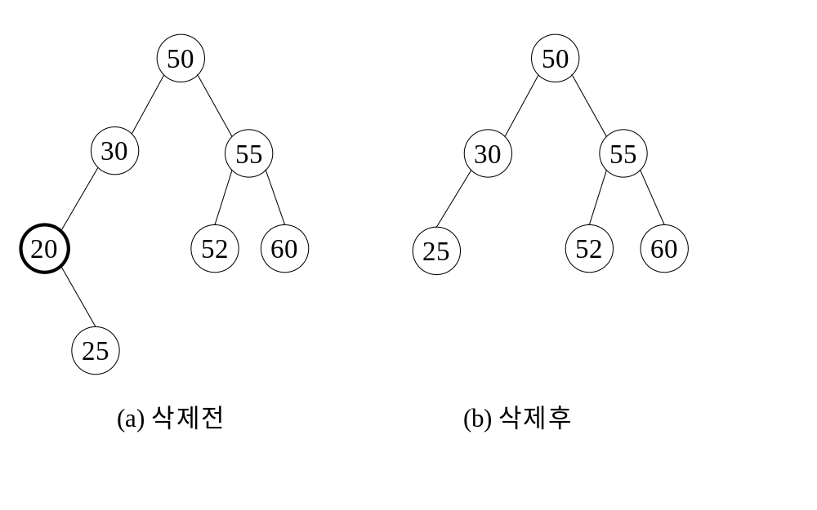
BST
  case 2.
  one child → delete and change the pointer to this child

Slide 30
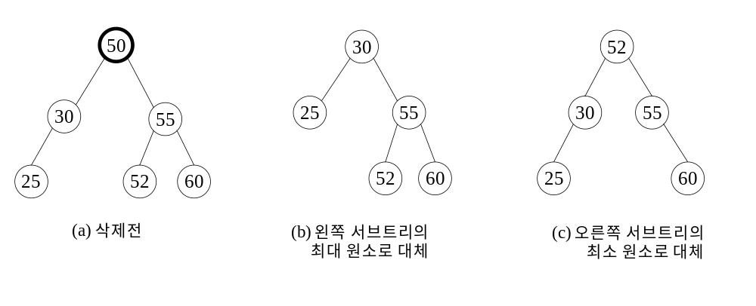
BST
  case 3. two child → either the smallest element in the right subtree or the largest element in the left subtree

Slide 31
Deletion algorithm
    deleteBST(B, x)
    p ← the node to be deleted; //주어진 키값 x를 가진 노드
    parent ← the parent node of p; // 삭제할 노드의 부모 노드
    if p = null then return false; // 삭제할 원소가 없음
    case {
    p.left = null and p.right = null : // 삭제할 노드가 리프 노드인 경우
    if parent.left = p then parent.right ← null;
    else parent.right ← null;
    p.left = null or p.right = null : // 삭제할 노드의 차수가 1인 경우
    if p.left ≠ null then {
    if parent.left = p then parent.left ← p.left;
    else parent.right ← p.left;
    } else {
    if parent.left = p then parent.left ← p.right;
    else parent.right ← p.right;
    }
    p.left ≠ null and p.right ≠ null : // 삭제할 노드의 차수가 2인 경우
    q ← maxNode(p.left); // 왼쪽 서브트리에서
    // 최대 키값을 가진 원소를 탐색
    p.key ← q.key;
    deleteBST(p.left, p.key);
    }
    end deleteBST()

Slide 32
Deleting from a Binary Search Tree
(BST)

Slide 33
The Scenario
We have a Binary Search Tree and want to remove some element based upon a match.
Must preserve “search” property
Must not lose any elements (i.e. only remove the one element)

Slide 34
BST Deletion
Search for desired item.
If not found, then return NIL or print error.
If found, perform steps necessary to accomplish removal from the tree.

Slide 35
Four Cases for Deletion
Delete a leaf node
Delete a node with only one child (left)
Delete a node with only one child (right)
Delete a node with two children
Cases 2 and 3 are comparable and only need slight changes in the conditional statement used

Slide 36
Delete a Leaf Node
50
Simply use an “in/out” pointer and assign it to “nil”. This will remove the node from the tree.
cur <- nil
14
94
9
42
71
116
13
66
108

Slide 37
Delete a Leaf Node
50
Simply use an “in/out” pointer and assign it to “nil”. This will remove the node from the tree.
cur <- nil
Let’s delete 42.
14
94
9
42
71
116
13
66
108

Slide 38
Delete a Leaf Node
50
Simply use an “in/out” pointer and assign it to “nil”. This will remove the node from the tree.
cur <- nil
Move the pointer;
now nothing points
to the node.
14
94
9
42
71
116
13
66
108

Slide 39
Delete a Leaf Node
50
Simply use an “in/out” pointer and assign it to “nil”. This will remove the node from the tree.
cur <- nil
The resulting tree.
14
94
9
71
116
13
66
108

Slide 40
Delete a Node with One Child
Use an “in/out” pointer.
Determine if it has a left or a right child.
Point the current
pointer to the appropriate child:
cur <- cur^.left_child
or
cur <- cur^.right_child
50
14
94
42
71
116
66
108

Slide 41
Delete a Node with One Child
Use an “in/out” pointer.
Determine if it has a left or a right child.
Point the current
pointer to the appropriate child:
cur <- cur^.left_child
or
cur <- cur^.right_child
Let’s delete 14.
50
14
94
42
71
116
66
108

Slide 42
Delete a Node with One Child
Use an “in/out” pointer.
Determine if it has a left or a right child.
Point the current
pointer to the appropriate child:
cur <- cur^.right_child
Move the pointer; now nothing points to the node.
50
14
94
42
71
116
66
108

Slide 43
Delete a Node with One Child
Use an “in/out” pointer.
Determine if it has a left or a right child.
Point the current
pointer to the appropriate child:
cur <- cur^.right_child
The resulting tree.
50
42
94
71
116
66
108

Slide 44
Delete a Node with One Child
Use an “in/out” pointer.
Determine if it has a left or a right child.
Point the current
pointer to the appropriate child:
cur <- cur^.left_child
or
cur <- cur^.right_child
Let’s delete 71.
50
14
94
42
71
116
66
108

Slide 45
Delete a Node with One Child
Use an “in/out” pointer.
Determine if it has a left or a right child.
Point the current
pointer to the appropriate child:
cur <- cur^.left_child
Move the pointer; now nothing points to the node.
50
14
94
42
71
116
66
108

Slide 46
Delete a Node with One Child
Use an “in/out” pointer.
Determine if it has a left or a right child.
Point the current
pointer to the appropriate child:
cur <- cur^.left_child
The resulting tree.
50
14
94
42
66
116
108

Slide 47
Delete a Node with Two Children
50
Copy a replacement
value from a descendant
node.
- Largest from left
- Smallest from right
Then delete that descendant node to remove the duplicate value.
- We know this will be an
easier case.
14
94
42
71
116
66
108

Slide 48
Delete a Node with Two Children
50
Let’s delete 50.
14
94
42
71
116
66
108

Slide 49
Delete a Node with Two Children
50
Look to the left
sub-tree.
14
94
42
71
116
66
108

Slide 50
Delete a Node with Two Children
50
42
Find and copy the
largest value
(this will erase the
old value but creates
a duplicate).
14
94
42
71
116
66
108

Slide 51
Delete a Node with Two Children
42
The resulting tree
so far.
14
94
42
71
116
66
108

Slide 52
Delete a Node with Two Children
42
Now delete the
duplicate from
the left sub-tree.
14
94
42
71
116
66
108

Slide 53
Delete a Node with Two Children
42
The final resulting
tree – still has search
structure.
14
94
71
116
66
108

Slide 54
Delete a Node with Two Children
50
Let’s delete 94.
14
94
42
71
116
66
108

Slide 55
Delete a Node with Two Children
50
Look to the right
sub-tree.
14
94
42
71
116
66
108

Slide 56
Delete a Node with Two Children
50
Find and copy the
smallest value
(this will erase the
old value but creates
a duplicate).
14
108
94
42
71
116
66
108

Slide 57
Delete a Node with Two Children
50
The resulting tree
so far.
14
108
42
71
116
66
108

Slide 58
Delete a Node with Two Children
50
Now delete the
duplicate from
the left sub-tree.
14
108
42
71
116
66
108

Slide 59
Delete a Node with Two Children
50
The final resulting
tree – still has search
structure.
14
108
42
71
116
66

Slide 60
Summary
Deleting a node from a binary search tree involves two steps:
  Search for the element
  Then perform the deletion
We must preserve the search structure and only delete the element which matches.
Four cases:
  Deleting a leaf node
  Deleting a node with only the left child
  Deleting a node with only the right child
  Deleting a node with both children

Slide 61
Binary Search Trees (7/8)
Height of a binary search tree
  The height of a binary search tree with n elements can become as large as n. (최악의 경우 높이 n )
  It can be shown that when insertions and deletions are made at random, the height of the binary search tree is O(log₂n) on the average. (랜덤하게 만들면 )
  Search trees with a worst-case height of O(log₂n) are called balance search trees(균형 탐색 트리) –높이가 O(log₂n) 을 보장

Slide 62
Binary Search Trees (8/8)
Time Complexity
  Searching, insertion, removal
    O(h), where h is the height of the tree
  Worst case - skewed binary tree
    O(n), where n is the # of internal nodes
Prevent worst case //최악의 경우를 회피방법
  rebalancing scheme
  AVL, 2-3, 2-3-4, and Red-black tree
A
A
B
B
C
C
D
D
E
E
(
a)
(
b)

Slide 63
Joining and Splitting Binary Trees(이진탐색트리 합병, 분할)
C.ThreeWayJoin(A, x, B): Creates a binary search tree C that consists of binary search tree A, B, and element x.
C.TwoWayJoin(A, B): Joins two binary search trees A and B to obtain a single binary search tree C.
A.Split(i, B, x, C): Binary search tree A splits into three parts: B (a binary search tree that contains all elements of A that have key less than i); if A contains a key i than this element is copied into x and a pointer to x returned; C is a binary search tree that contains all records of A that have key larger than i.

Slide 64
ThreeWayJoin(A, x, B)
81
30
90
5
40
81
85
94
2
35
80
84
92
A
x
B

Slide 65
TwoWayJoin(A, B)
80
84
30
90
5
40
85
94
2
35
80
84
92
A
B

Slide 66
A.Split(i, B, x, C)
30
x
i = 30
5
40
2
35
80
B
75
81
A
C

Slide 67
A.Split(i, B, x, C)
i = 80
30
t
Y
L
Z
R
30
L
81
5
40
t
R
5
C
40
L
2
35
80
t
2
35
75
80
75
81
x
A
B

Slide 68
Find Maximum(최대값찾기)
Find maximum is another common operation in binary search trees and is helpful when implementing deletion.
Again the recursive thinking makes this implementation much easier to understand
The idea is simple. If a node has a non-null pointer to the right this node cannot be the maximum as the element in the right must be greater. //루트에서 출발, 오른쪽으로 한없이 내려간다.
findMax ()
1. If head of the tree is null return null;
2. If the right pointer from the head is null head is
the maximum
3. Else (it is not null) return the result of findMax in the right
subtree

Slide 69
Find Minimum(최소값찾기)
The idea of finding the minimum value in a binary search tree will also help the delete operation
Its idea is very much like the maximum //루트에서출발, 왼쪽으로 한없이 내려간다
findMin ()
1. If head of the tree is null return null;
2. If the left pointer from the head is null head is
the minimum
3. Else (it is not null) return the result of findMin in the left
subtree

Slide 70
Comparing Binary Search Trees to Linear Lists
Big-O Comparison
Operation | Binary Search Tree | Array-based List | Linked List
RetrieveItem | O(logN) | O(logN) | O(N)
InsertItem | O(logN) | O(N) | O(N)
DeleteItem | O(logN) | O(N) | O(N)

Slide 71
이원 탐색 트리의 Java 구현 및 검색 (2)
이원 탐색 트리 구축 및 탐색 프로그램
class TreeNode {
String key;
TreeNode left;
TreeNode right;
}
class BinarySearchTree {
private TreeNode rootNode; ;

Slide 72
이원 탐색 트리의 Java 구현 및 검색 (3)
private TreeNode insertKey(TreeNode T, String x) {
// insert() 메소드에 의해 사용되는 보조 순환 메소드
if (T==null) {
TreeNode newNode = new TreeNode();
newNode.key = x;
return newNode;
} else if (x.compareTo(T.key) < 0) { // x < T.key이면 x를 T의 왼쪽
T.left = insertKey(T.left, x); // 서브트리에 삽입
return T;
} else if (x.compareTo(T.key) > 0) { // x > T.key이면 x를 T의 오른쪽
T.right = insertKey(T.right, x); // 서브트리에 삽입
return T;
} else { // key값 x가 이미 T에 있는 경우
return T;
}
} // end insertKey()

Slide 73
이원 탐색 트리의 Java 구현 및 검색 (4)
  void insert(String x) {
  rootNode = insertKey(rootNode, x);
  } // end insert()
  TreeNode find(String x) { // 키값 x를 가지고 있는 TreeNode의
  TreeNode T = rootNode; // 포인터를 반환
  int result;
  while (T != null) {
  if ((result = x.compareTo(T.key)) < 0) {
  T = T.left;
  } else if (result == 0) {
  return T;
  } else {
  T = T.right;
  } // end if
  }
  return T;
  } // end find()

Slide 74
이원 탐색 트리의 Java 구현 및 검색 (5)
  private void printNode(TreeNode N) { // print() 메소드에 의해
  if (N != null) { // 사용되는 순환 메소드
  System.out.print("(");
  printNode(N.left);
  System.out.print(N.key);
  printNode(N.right);
  System.out.print(")");
  }
  } // end printNode()
  void printBST() { // 서브트리 구조를 표현하는 괄호 형태로 트리를 프린트
  printNode(rootNode);
  System.out.println();
  } // end printBST()
  } // end BinarySearchTree class

Slide 75
이원 탐색 트리의 Java 구현 및 검색 (6)
  class BinarySearchTreeTest {
  public static void main(String args[]) {
  BinarySearchTree T = new BinarySearchTree();
  // 그림 8.6의 BST를 구축
  T.insert("S");
  T.insert("J");
  T.insert("B");
  T.insert("D");
  T.insert("U");
  T.insert("M");
  T.insert("R");
  T.insert("Q");
  T.insert("A");
  T.insert("G");
  T.insert("E");
  // 구축된 BST를 프린트
  System.out.println(" The Tree is:");
  T.printBST();
  System.out.println();
  // 스트링 "R"을 탐색하고 프린트

Slide 76
이원 탐색 트리의 Java 구현 및 검색 (7)
  System.out.println(" Search For \"R\"");
  TreeNode N = T.find("R");
  System.out.println("Key of node found = " + N.key);
  System.out.println();
  // 스트링 "C"를 탐색하고 프린트
  System.out.println(" Search For \"C\"");
  TreeNode P = T.find("C");
  if (P != null) {
  System.out.println("Key of node found = " + P.key);
  } else {
  System.out.println("Node that was found = null");
  }
  System.out.println();
  } // end main()
  } // end BinarySearchTreeTest class

Slide 77
Heaps (1/6)
The heap abstract data type
  Definition: A max(min) tree is a tree in which the key value in each node is no smaller (larger) than the key values in its children. A max (min) heap is a complete binary tree (완전이진트리)that is also a max (min) tree
  Basic Operations:
    creation of an empty heap
    insertion of a new element into a heap
    deletion of the largest element from the heap

Slide 78
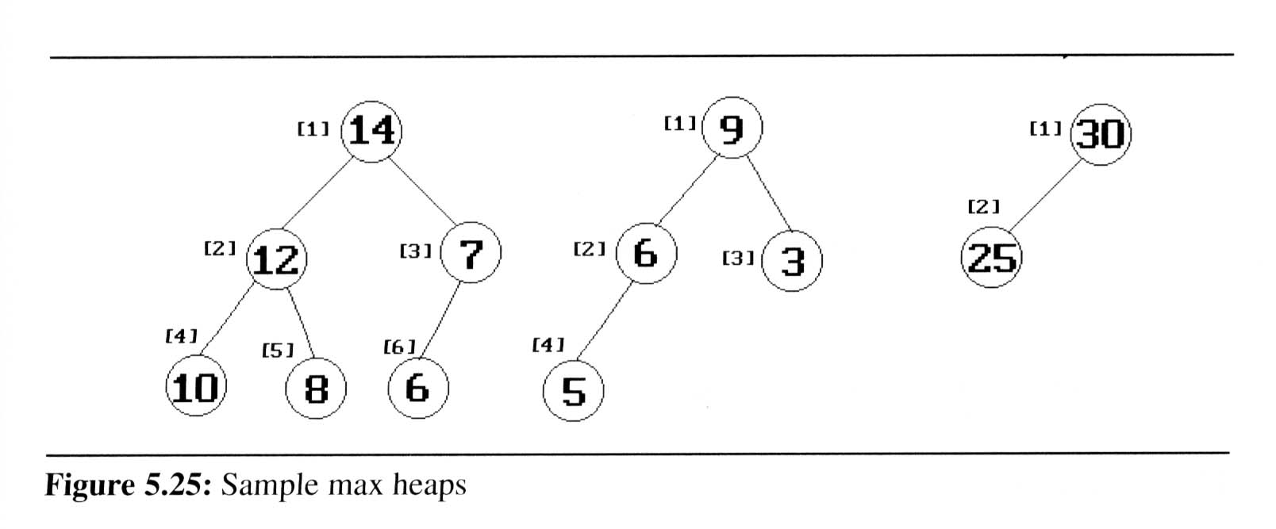
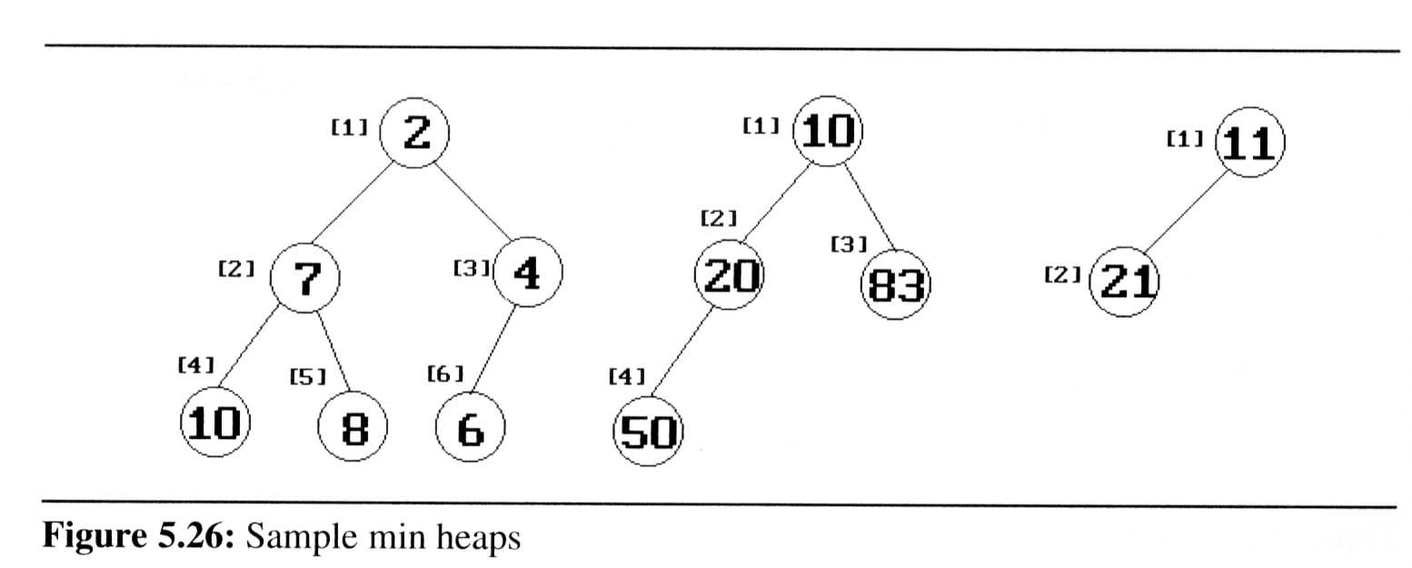
Heaps (2/6)
The examples of max heaps and min heaps
  Property: The root of max heap (min heap) contains the largest (smallest) element

Slide 79
Heaps (3/6)
Abstract data type of Max Heap
  ADT Heap
  Data : n>0 원소로 구성된 완전 이진 트리로 각 노드의 키값은 그의
  자식 노드의 키값보다 작지 않다.
  Operators :
    H∈Heap; e ∈Element;
    createHeap() := create an empty heap;
    insertHeap(H,e) := insert a new item e into H
    isEmpty(H) := if the heap H is empty
    then return true
    else return false
    deleteHeap(H) := if isEmpty(H) then null
    else {
    e ← the largest element in H;
    remove the largest element in H;
    return e;
    }
End Heap

Slide 80
Heaps (4/6)
Queue : FIFO
Priority queues
  Heaps are frequently used to implement priority queues (히프는 우선순위큐 구현에 최적)
  delete the element with highest (lowest) priority
  insert the element with arbitrary priority
  Heaps is the only way to implement priority queue

Slide 81
Binary Heaps: Array Implementation
Implementing binary heaps.
  Use an array: no need for explicit parent or child pointers.
    Parent(i) = ⎣i/2⎦
    Left(i) = 2i
    Right(i) = 2i + 1
06
1
14
45
2
3
78
18
47
53
4
5
6
7
83
91
81
77
84
99
64
8
9
10
11
12
13
14
Notes:
parent and children formula require only simple bit twiddling operations

Slide 82
Binary Heap: Insertion
Insert element x into heap.
  Insert into next available slot.
  Bubble up until it's heap ordered.
    Peter principle: nodes rise to level of incompetence
06
14
45
78
18
47
53
83
91
81
77
84
99
64
42
next free slot

Slide 83
Binary Heap: Insertion
Insert element x into heap.
  Insert into next available slot.
  Bubble up until it's heap ordered.
    Peter principle: nodes rise to level of incompetence
swap with parent
06
14
45
78
18
47
53
83
91
81
77
84
99
64
42
42

Slide 84
Binary Heap: Insertion
Insert element x into heap.
  Insert into next available slot.
  Bubble up until it's heap ordered.
    Peter principle: nodes rise to level of incompetence
swap with parent
06
14
45
78
18
47
42
83
91
81
77
84
99
64
42
53

Slide 85
Binary Heap: Insertion
Insert element x into heap.
  Insert into next available slot.
  Bubble up until it's heap ordered.
    Peter principle: nodes rise to level of incompetence
  O(log N) operations.
stop: heap ordered
06
14
42
78
18
47
45
83
91
81
77
84
99
64
53

Slide 86
Binary Heap: Decrease Key
Decrease key of element x to k.
  Bubble up until it's heap ordered.
  O(log N) operations.
06
14
42
78
18
47
45
83
91
81
77
84
99
64
53

Slide 87
Binary Heap: Delete Min
히프에서 삭제는 루트만을 삭제함.
06
14
42
78
18
47
45
83
91
81
77
84
99
64
53

Slide 88
Binary Heap: Delete Min
Delete minimum element from heap.
  Exchange root with rightmost leaf.
  Bubble root down until it's heap ordered.
    power struggle principle: better subordinate is promoted
06
14
42
78
18
47
45
83
91
81
77
84
99
64
53

Slide 89
Binary Heap: Delete Min
Delete minimum element from heap.
  Exchange root with rightmost leaf.
  Bubble root down until it's heap ordered.
    power struggle principle: better subordinate is promoted
53
14
42
78
18
47
45
83
91
81
77
84
99
64
06

Slide 90
Binary Heap: Delete Min
Delete minimum element from heap.
  Exchange root with rightmost leaf.
  Bubble root down until it's heap ordered.
    power struggle principle: better subordinate is promoted
exchange with left child
53
14
42
78
18
47
45
83
91
81
77
84
99
64

Slide 91
Binary Heap: Delete Min
Delete minimum element from heap.
  Exchange root with rightmost leaf.
  Bubble root down until it's heap ordered.
    power struggle principle: better subordinate is promoted
exchange with right child
14
53
42
78
18
47
45
83
91
81
77
84
99
64

Slide 92
Binary Heap: Delete Min
Delete minimum element from heap.
  Exchange root with rightmost leaf.
  Bubble root down until it's heap ordered.
    power struggle principle: better subordinate is promoted
  O(log N) operations.
stop: heap ordered
14
18
42
78
53
47
45
83
91
81
77
84
99
64

Slide 93
Insertion algorithm
  insertHeap(Heap,e)
  // 순차 표현으로 구현된 최대 히프
  // 원소 e를 히프 Heap에 삽입, n은 현재 히프의 크기(원소 수)
  if (n = maxSize) then heapFull; // 히프가 만원이면 히프 크기를 확장
  n←n+1; // 새로 첨가될 노드 위치
  for (i←n; ; ) do {
  if (i = 1) then exit; // 루트에 삽입
  if(e.key ≤ Heap[ i/2 ].key) then exit; // 삽입할 노드의 키값과
  // 부모 노드 키값을 비교
  Heap[i] ← Heap[ i/2 ]; // 부모 노드 키값을 자식노드로 이동
  i ← i/2 ;
  }
  Heap[i] ← e;
  end insertHeap()

Slide 94
Deletion algorithm
    deleteHeap(heap)
    // 히프로부터 원소 삭제, n은 현재의 히프 크기(원소 수)
    if (n=0) then return error; // 공백 히프
    item ← heap[1]; // 삭제할 원소
    temp ← heap[n]; // 이동시킬 원소
    n ← n-1; // 히프 크기(원소 수)를 하나 감소
    i ← 1;
    j ← 2; // j는 i의 왼쪽 자식 노드
    while (j ≤ n) do {
    if (j < n) then if (heap[j] < heap[j+1])
    then j ← j+1; // j는 값이 큰 자식을 가리킨다.
    if (temp ≥ heap[j]) then exit;
    heap[i] ← heap[j]; // 자식을 한 레벨 위로 이동
    i ← j;
    j ← j*2; // i와 j를 한 레벨 아래로 이동
    }
    heap[i] ← temp;
    return item;
    end deleteHeap()

Slide 95
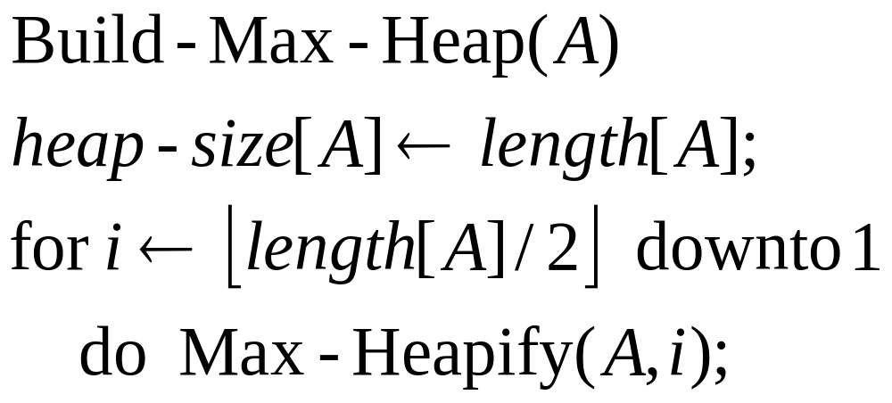
Building a Heap
e.g., 4, 1, 3, 2, 16, 9, 10, 14, 8, 7.

Slide 96
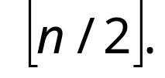


자식이 있는 마지막 서브트리는 에 위치
1
4
2
1
3
3
4
2
5
16
6
9
7
10
8
9
8
10
14
7

Slide 97
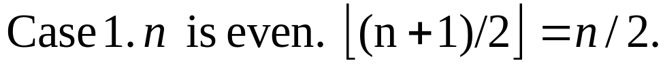

4
1
3
2
5
9
10
16
10
11
14
8
7
7

Slide 98
Max-Heapify(5)
4
1
3
2
5
9
10
16
14
8
7
5를 루트로 하는 서브트리를 히프로 만든다

Slide 99
Max-Heapify(4)
4
1
3
4
2
16
9
10
14
8
7
4를 루트로 하는 서브트리를 히프로 만든다

Slide 100
Max-Heapify(4)
4
1
3
4
16
9
10
14
2
8
7

Slide 101
Max-Heapify(3)
4
1
3
3
14
16
9
10
2
8
7
3을 루트로 하는 서브트리를 히프로 만든다

Slide 102
Max-Heapify(3)
4
1
3
10
14
16
9
3
2
8
7

Slide 103
Max-Heapify(2)
4
2
1
10
14
16
9
3
2
8
7
2를 루트로 하는 서브트리를 히프로 만든다

Slide 104
Max-Heapify(2)
4
2
16
10
14
1
9
3
2
8
7

Slide 105
Max-Heapify(1)
1
4
16
10
14
7
9
3
2
8
1
1을 루트로 하는 서브트리를 히프로 만든다

Slide 106
Max-Heapify(1)
1
16
4
10
14
7
9
3
2
8
1

Slide 107
Max-Heapify(1)
1
16
14
10
4
7
9
3
2
8
1

Slide 108
Max-Heapify(5)
1
16
14
10
7
9
3
8
2
4
1

Slide 109
Priority Queue using Heap
히프를 사용한 우선순위

Slide 110
class PriorityQueue{
private int count; // 우선순위 큐의 현재 원소수
private int size; // 배열의 크기
private int increment; // 배열 확장 단위
private PrioityElement[] itemArray; // 우선순위 큐 원소를 저장하는 배열
public PriorityQueue(){
count = 0; // itemArray[0]는 실제로 사용하지 않음
size = 16; //실제 최대 원소 수는 size - 1
increment = 8;
itemArray = new PrioityElement[size];
}
public int currentSize(){ // 우선순위 큐의 현재 원소수
return count;
}

Slide 111
public void insert(PrioityElement newKey){
// 우선순위 큐에 원소 삽입
if (count == size-1) PQFull();
count++; // 삽입 공간을 확보하고 원소의 삽입 위치를 밑에서부터 찾아 올라감
int childLoc = count;
int parentLoc = childLoc/2;
while (parentLoc != 0) {
if (newKey.compareTo(itemArray[parentLoc]) <= 0) {
// 위치가 올바른 경우
itemArray[childLoc] = newKey; // 원소 삽입
return;
} else { // 한 레벨 위의 위치로 이동
itemArray[childLoc] = itemArray[parentLoc];
childLoc = parentLoc;
parentLoc = childLoc/2 ;
}
}
itemArray[childLoc] = newKey; // 최종 위치에 원소 삽입
} // end insert()

Slide 112
public void PQFull() {
// itemArray가 만원이면
size += increment; // increment만큼 더 크게 확장
PriorityElement[] tempArray = new PriorityElement[size];
for (int i = 1; i < count; i++) {
tempArray[i] = itemArray[i];
}
itemArray= tempArray;
} // end PQFull()
public PriorityElement delete() {
// 우선순위 큐로부터 원소 삭제
if (count == 0) { // 우선순위 큐가 공백인 경우
return null;
}
else {
// 변수 선언
int currentLoc;
int childLoc;
PriorityElement itemToMove; // 이동시킬 원소
PriorityElement deletedItem; // 삭제한 원소
  deletedItem = itemArray[1]; // 삭제하여 반환할 원소

Slide 113
itemToMove = itemArray[count--]; // 이동시킬 원소
currentLoc = 1;
childLoc = 2*currentLoc;
while (childLoc <= count) { // 이동시킬 원소의 탐색
if (childLoc < count) {
if (itemArray[childLoc+1].compareTo(itemArray[childLoc]) > 0)
childLoc ++;
}
if (itemArray[childLoc].compareTo(itemToMove) > 0) {
itemArray[currentLoc]=itemArray[childLoc]; // 원소를 한 레벨
currentLoc = childLoc; // 위로 이동
childLoc = 2*currentLoc;
} else {
itemArray[currentLoc]=itemToMove; // 이동시킬 원소 저장
return deletedItem;
}
} // end while
itemArray[currentLoc] = itemToMove; // 최종 위치에 원소 저장
return deletedItem;
} // end if
} // end delete()
} // end PriorityQueue class

Slide 114
Selection Trees(선택 트리)

Slide 115
Selection Trees (1/6)
Problem:
  suppose we have k order sequences, called runs, that are to be merged into a single ordered sequence
Solution:
  straightforward : k-1 comparison
  selection tree : ⎡log₂k⎤+1
There are two kinds of selection trees:
winner trees and loser trees

Slide 116
Selection Trees (2/6)
Definition: (Winner tree)
  a selection tree is the binary tree where each node represents the smaller of its two children
  root node is the smallest node in the tree
  a winner is the record with smaller key
Rules:
  tournament : between sibling nodes
  put X in the parent node ⇒ X tree
  where X = winner or loser

Slide 117
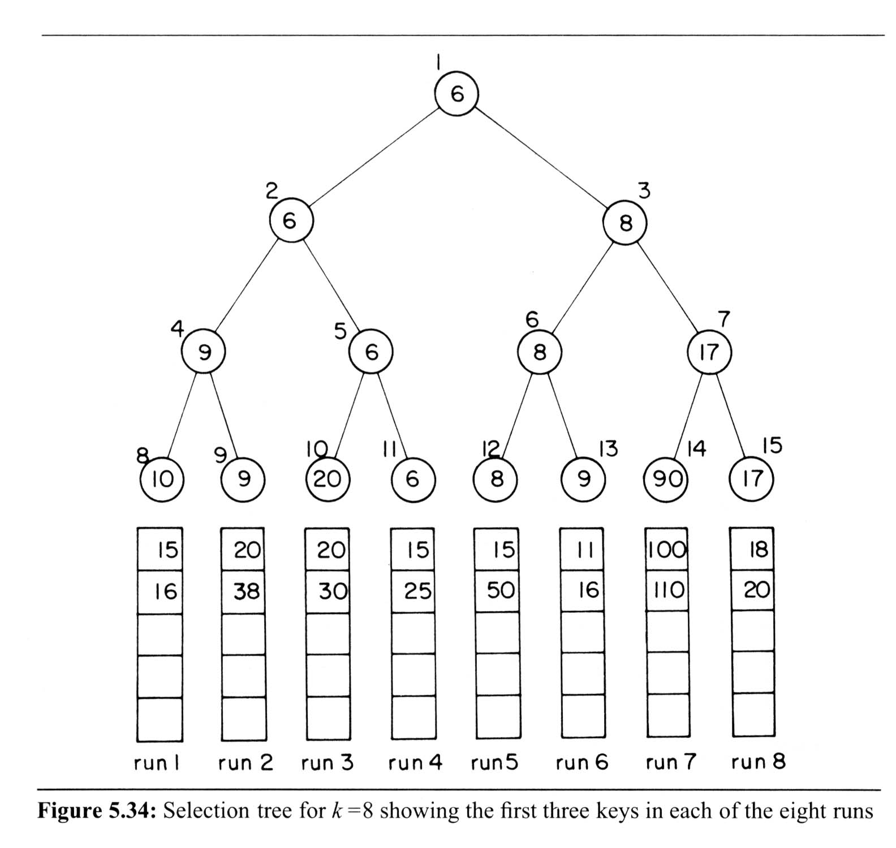
Selection Trees (3/6)
Winner Tree
sequential allocation
scheme
(complete
binary tree)
Each node represents
the smaller of its two
children
ordered sequence

Slide 118
Selection Trees (4/6)
Analysis of merging runs using winner trees
  # of levels: ⎡log₂K ⎤ +1 ⇒ restructure time: O(log₂K)
  merge time: O(nlog₂K)
  setup time: O(K)
  merge time: O(nlog₂K)
Slight modification: tree of loser
  consider the parent node only (vs. sibling nodes)

Slide 119
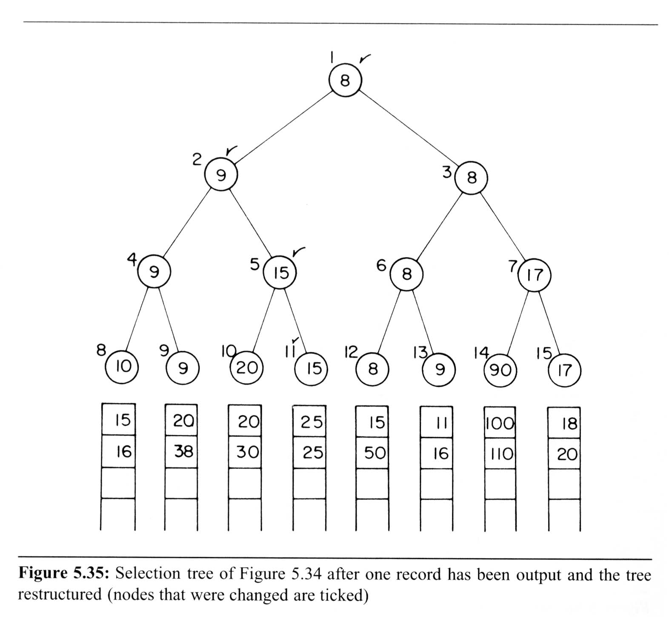
Selection Trees (5/6)
After one record has been output
6
6
6
6
15

Slide 120
Selection Trees (6/6)
Tree of losers can be conducted by Winner tree
0
6
8
9
17
10
20
9
90

Slide 121
Selection Trees
When trying to merge k ordered sequences (assume in non-decreasing order) into a single sequence, the most intuitive way is probably to perform k – 1 comparison each time to select the smallest one among the first number of each of the k ordered sequences. This goes on until all numbers in every sequences are visited.
There should be a better way to do this.

Slide 122
Winner Tree
A winner tree is a complete binary tree in which each node represents the smaller of its two children. Thus the root represents the smallest node in the tree.
Each leaf node represents the first record in the corresponding run.
Each non-leaf node in the tree represents the winner of its right and left subtrees.

Slide 123
Winner Tree For k = 8
1
6
2
3
6
8
4
5
6
7
9
6
8
17
8
9
10
11
12
13
14
15
10
9
20
6
8
9
90
17
15
20
20
15
15
11
95
18
16
38
30
25
50
16
99
20
28
run1
run2
run3
run4
run5
run6
run7
run8

Slide 124
Winner Tree For k = 8
1
8
2
3
9
8
4
5
6
7
9
15
8
17
8
9
10
11
12
13
14
15
10
9
20
15
8
9
90
17
15
20
20
25
15
11
95
18
16
38
30
28
50
16
99
20
run1
run2
run3
run4
run5
run6
run7
run8

Slide 125
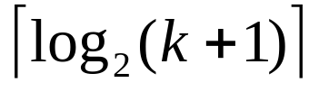
Analysis of Winner Tree
The number of levels in the tree is
  The time to restructure the winner tree is O(log₂k).
Since the tree has to be restructured each time a number is output, the time to merge all n records is O(n log₂k).
The time required to setup the selection tree for the first time is O(k).
Total time needed to merge the k runs is O(n log₂k).

Slide 126
Loser Tree
A selection tree in which each nonleaf node retains a pointer to the loser is called a loser tree.
Again, each leaf node represents the first record of each run.
An additional node, node 0, has been added to represent the overall winner of the tournament.

Slide 127
Loser Tree
0
6
Overall winner
1
8
2
3
9
17
4
5
6
7
10
20
9
90
9
10
11
12
13
14
15
10
9
20
6
8
9
90
17
run
1
2
3
4
5
6
7
8

Slide 128
Loser Tree
0
8
Overall winner
1
9
2
3
15
17
4
5
6
7
10
20
9
90
9
10
11
12
13
14
15
10
9
20
15
8
9
90
17
run
1
2
3
4
5
6
7
8

